Slide 1
Static and Dynamic Libraries
By Vishwa Gangadhar

Slide 2
Introduction
Linking is a crucial step in the software development process.
It connects different modules of a program to create a final executable.
The "ld" command is the linker that performs this task.

Slide 3
Why Linking?
Linking is needed to combine object files and libraries into a cohesive program.
It resolves symbols, addresses, and dependencies among different modules.
The linker ensures that the program can execute correctly.

Slide 4
Static Linking
Static linking incorporates library code directly into the executable.
All necessary library code is copied into the final machine code.
The resulting executable is not dependent on external libraries.

Slide 5
Working of static linking
In static linking, the libraries that are asked to be included in he program file is added in the machine code directly during pre-processing. Hence there is no need for a linker during runtime and the machine code can run without any dependencies.

Slide 6
Dynamic Linking
Dynamic linking keeps library code separate from the executable.
The executable references shared libraries at runtime.
Multiple programs can share the same copy of the library code.

Slide 7
Working of Dynamic Linking
We use dynamic linking in our PDS course and writing basic programs. The linker stores the address of the library that has been included in the program file. Then during execution, when the function comes up, the linker uses the address to reach the library and gets the function. After that first execution of that function, it knows the address from the linker. Hence automatically executes it without the linker.

Slide 8
Advantages of Static Linking
Portability: Static linked executables are self-contained and do not depend on external libraries.
Performance: Static linking eliminates runtime library loading overhead.
Simplicity: There are no additional dependencies or runtime configuration requirements.

Slide 9
Disadvantages of Static Linking
Increased size: Each statically linked executable carries its own copy of library code, resulting in larger file sizes.
Update difficulties: If a library needs an update, every statically linked program must be recompiled and relinked.

Slide 10
Advantages of Dynamic Linking
Reduced size: Shared libraries are loaded at runtime, leading to smaller executable sizes.
Code sharing: Multiple programs can share the same copy of the library code, saving memory resources.
Easy updates: Updating a shared library allows all programs using it to benefit without recompilation.

Slide 11
Disadvantages of Dynamic Linking
Dependency management: Dynamic linked executables require the correct shared libraries to be present on the system.
Runtime overhead: Loading shared libraries incurs a slight overhead during program startup.
Version compatibility: Different versions of shared libraries can lead to compatibility issues.

Slide 12
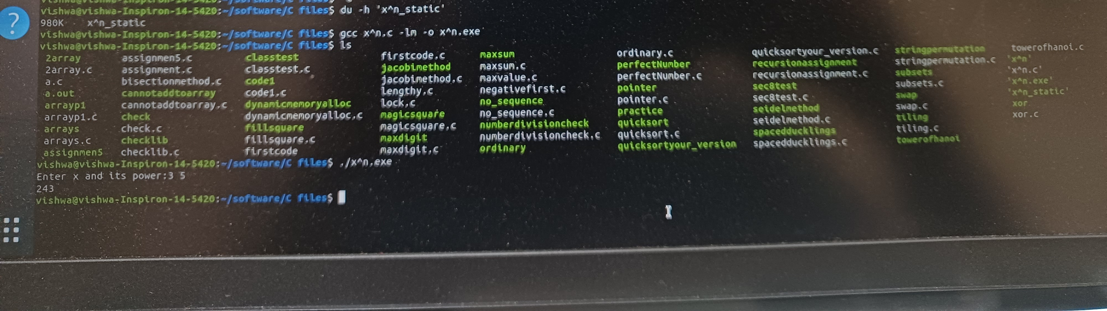
Dynamic linking of C program x^n.c

Slide 13
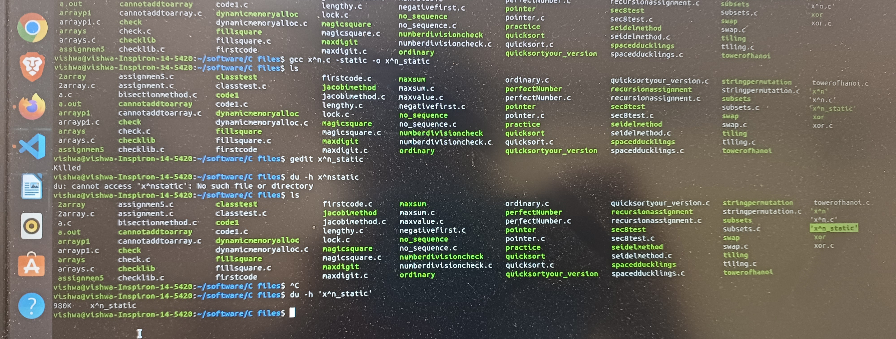
Static Linking of C program x^n.c

Slide 14
ld Command
The "ld" command performs the linking process.
It takes object files and libraries as input and creates an executable or shared library.
The "ld" command resolves symbols, handles dependencies, and produces the final binary.

Slide 15
Command Syntax
The basic syntax of the "ld" command is as follows:
ld [options] input_files -o output_file

Slide 16
Common Options
-L<dir>: Specify directories to search for libraries.
-l<lib>: Link against a specific library.
-rpath=<dir>: Set runtime library search path.
-nostdlib: Do not use standard system libraries.
-static: Create a fully static executable.

Slide 17
Conclusion
Linking is a vital step in software development, connecting different program modules.
Static and dynamic linking offer different trade-offs in terms of portability, performance, and ease of updates.
The "ld" command facilitates the linking process, resolving symbols and dependencies to create the final executable.

Slide 18
Thank You
Any questions

